Slide 1




Course name: Electrical & Electronics System (EE1002)
B.TECH FIRST YEAR
ACADemic YEAR: 2023-2024
Course code : EE 1002
lecture series no : 01 (one)
Credits : 04
Mode of delivery : oFF line (Power point presentation)
Faculty : HIMANSHU PRIYADARSHI
Email-id : Himanshu.priyadarshi@jaipur.manipal.edu
PROPOSED DATE OF DELIVERY: 16 Aug 2023

Slide 2
Session outcome
“Analyse and calculate different quantities pertaining to parallel ac circuits”

Slide 3
Assessment criteria’S
Assignment,
Quiz, Mid terms and End term.

Slide 4

CO2 mapped with PROGRAM OUTCOMES MAPPING WITH [po1],[po2], & [po12]

Slide 5

Dept. of Electrical & Electronics Engineering School of Electrical, Electronics & Communication SEEC Faculty of Engineering
Single Phase Circuits
Series & Parallel Resonance, Resonant frequency, Voltage & Current magnification, Dynamic resistance
Lecture 13 - 15

Slide 6

Contents
Single Phase Circuits:
1. Series Resonance
2. Parallel Resonance
Resonant frequency
Voltage & Current magnification
Dynamic resistance

Slide 7
Series Resonance
Reference books :
Chapter 13 of Hughes E, Electrical and Electronic Technology (8th e), Pearson Education, 2002.
Chapter 4(4.14) of T.K.Nagsarkar & M.S.Sukhija, Basic Electrical Engineering, OXFORD University Press.

Slide 8
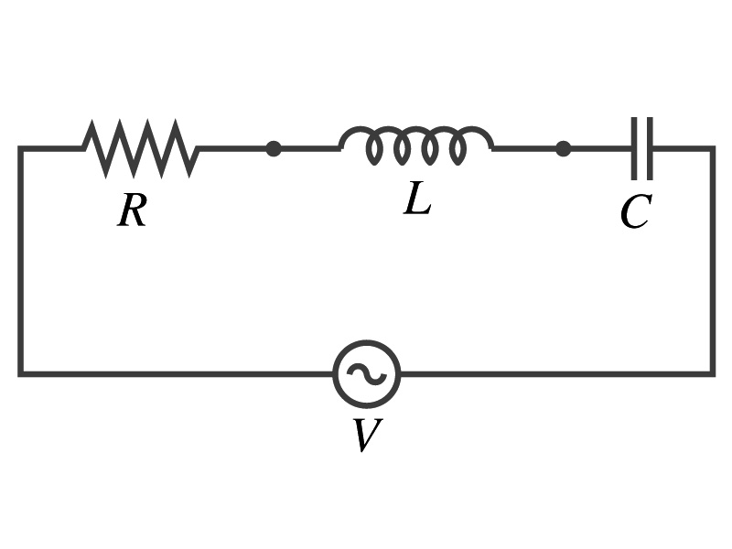
SERIES RESONANCE - RLC Series Circuit
v(t), variable frequency
Is said to be in resonance, when
Current is in phase with voltage
Inductive reactance =Capacitive reactance; X_{L} = X_{C}
Circuit Power factor is unity
Effective Circuit impedance is resistive; Z = R

Slide 9
SERIES RESONANCE - Resonant frequency (f₀)
At series Resonance
Resonant frequency (f₀)
v(t), variable frequency

Slide 10
Variation of Reactance with frequency
Series Resonance
X_{L}=ωL
X_{L}=ωL
X_{L}=ωL
X_{L}=ωL
X_{L}=ωL
R
R
R
R
R
o
o
o
o
o
ω_{o}
ω
ω
ω
ω
ω
X_{C}=-1/ωC
X_{C}=-1/ωC
X_{C}=-1/ωC
X_{C}=-1/ωC
X_{C}=-1/ωC
ω₀ is the resonance frequency.

Slide 11
SERIES RESONANCE - Variation of Current
I₀
I
Acceptor circuit
ω_{o}
ω
at resonance I_{rms} is maximum when X_{L} = X_{C};

Slide 12
SERIES RESONANCE - Variation of phase angle
o
ω_{o}
ω
For -
ω< ω_{o}; X_{C}>X_{L} leading current
ω= ω_{o}; X_{C}=X_{L} in phase current
ω> ω_{o}; X_{C}<X_{L} lagging current

Slide 13
Series Resonance - Bandwidth and Half Power frequencies
i
I_{O}
= Half the power at
resonant frequency
ω₁
ω_{o}
ω₂
ω
ω₁ = lower half power frequency
ω₂ = upper half power frequency
Band Width = ω₂- ω₁

Slide 14
Relation between Band Width and Half Power Frequencies

Slide 15
Series Resonance - Q - Factor
Quality factor- a measure of selectivity

Slide 16
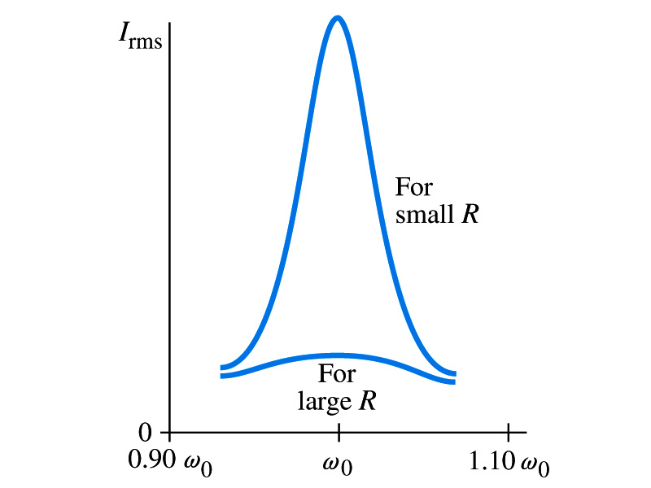
SERIES RESONANCE - Voltage Magnification
At Series Resonance
Sharpness of resonance depends on R
Small R gives sharp resonance
Large R gives broad resonance

Slide 17
Parallel Resonance

Slide 18
PARALLEL RESONANCE - Characteristics
At Resonance Voltage and current must be in phase
Hence in the case of Parallel Resonance :
The admittance of the circuit is minimum at resonance so Z is maximum & I in minimum.
The current (maximum) drawn from the supply is V/R
The currents I_{C} and I_{L} are equal and opposite.
Power factor is unity
Net susceptance is zero
iR
iL
iC
R
L
C
v(t)

Slide 19
PARALLEL RESONANCE - Resonant frequency (f_{r})
For pure RLC parallel circuit
At resonance, the net susceptance is zero for Parallel Resonance.
Same expression as in case of Series resonance
Let ω be variable and ω_{r} = Resonant frequency (f_{r})
iR
iL
iC
R
L
C
v(t)

Slide 20
PARALLEL RESONANCE - Resonant frequency (f_{r})
For the Circuit shown…
At resonance, the net susceptance is zero for Parallel Resonance (ωC – 1/ ωL)=0 .
R
v(t)
C
L
1
⎛
R
⎞
2
ω
=
−
⎜
⎟
r
LC
⎝
L
⎠

Slide 21
PARALLEL RESONANCE - Current magnification
I
R
v(t)
I
C
L
ωL
L
I
Φ
C
Φ
R
At resonance, I_{L} and I_{C} >>>I
Current magnification,

Slide 22
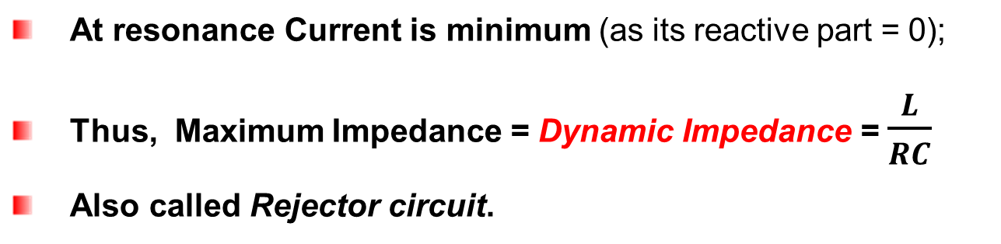
PARALLEL RESONANCE - Variation of current
I
o
ω_{r}
ω
At resonance Current is minimum (as its reactive part = 0);
Thus, Maximum Impedance = Dynamic Impedance = $\frac{L}{RC}$
Also called Rejector circuit.

Slide 23



$$Q Factor$$
Defined as the ratio of the line current ($I_{o}$) , circulating between the two branches of the parallel circuit to the line current.
were, $I_{o}=\frac{V}{L/RC}$
Thus, $Q_{factor}=\frac{ωL}{R}$
And at resonance,
$Q_{factor}=\frac{ω_{o}L}{R}=\frac{1}{\sqrt{LC}}.\frac{L}{R}=\frac{1}{R}\sqrt{\frac{L}{C}}$
In series circuit $Q_{factor}$ gives Voltage Magnification &
In parallel circuit $Q_{factor}$ gives Current Magnification.

Slide 24
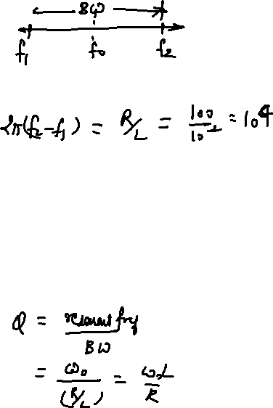
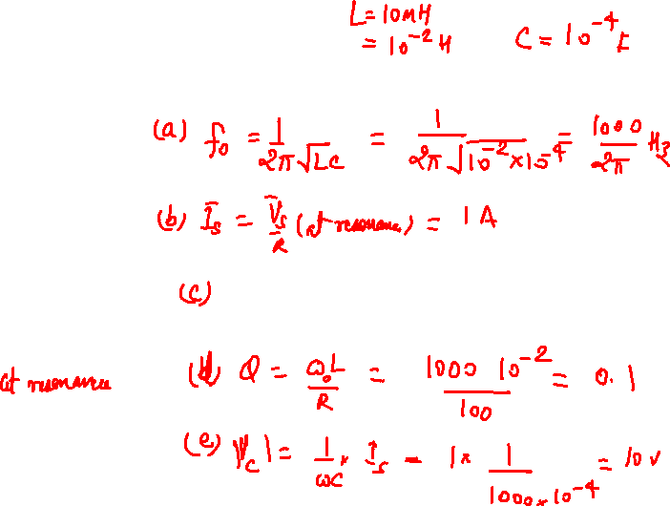
Solved Examples
[1] A series RLC circuit consisting of R=100Ω, L=10mH and C=100μF is supplied by an ac supply of 100 volt at varying frequency.
Determine
Resonant frequency
Current at resonance
Half power frequencies
Q factor
Voltage across capacitor

Slide 25
Sol.

Slide 26
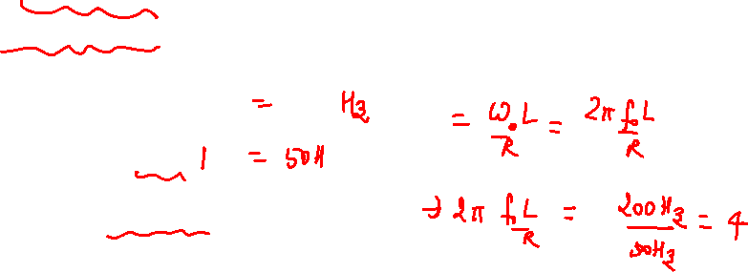
[2] An RLC series circuit of R=8Ω resistance should be designed to have a bandwidth of 50 Hz. Determine the value of L and C so that the system resonates at 200 Hz.

Slide 27
[3] The parallel circuit shown in figure is made to resonate by varying L. Find the value of L if ω=5000rad/sec .
Sol.
Z₁=5-j10Ω
Z₂=2+jX_{L}Ω
Im(Y₁+Y₂)=Im(Y) =
X_{L} = 12.17 Ω or 0.3286Ω
L = 65.73μH or 2.434mH

Slide 28
[4] Show that circuit given in figure will be at resonance at supply frequency
Sol.
Given ω=1.4 rad/sec
Find overall impedance (admittance)
If it results in real answer, then frequency at resonance is 1.4 rad/sec

